Slide 1
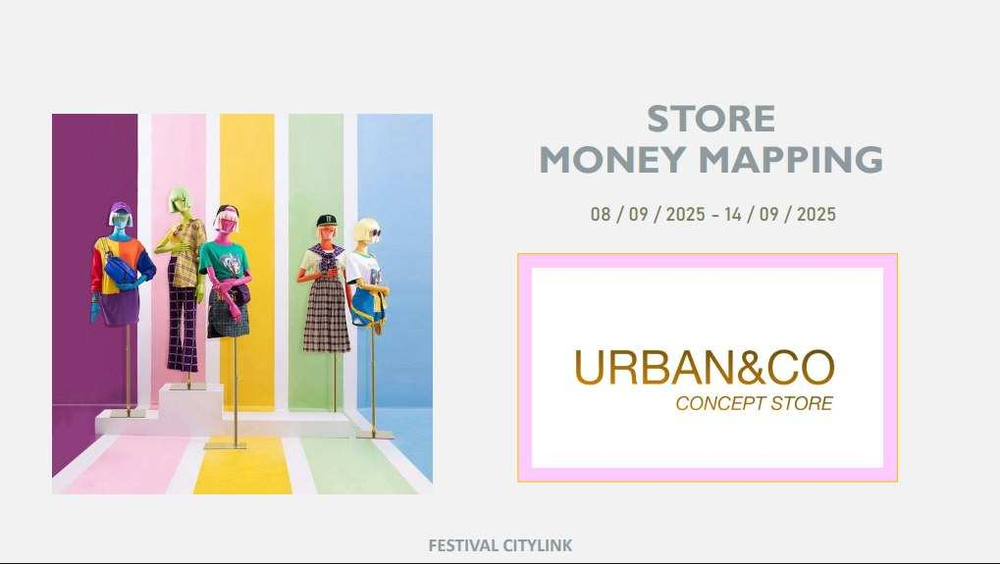
RANKING POSITION LADIES
19 – 25 OCT 2026

Slide 2
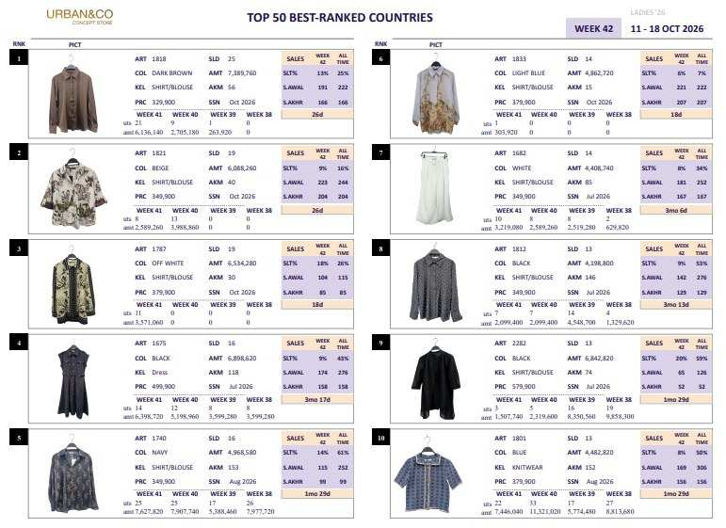
FESTIVAL CITYLINK
POSITION RANKING
19 – 25 OCT 2026

Slide 3
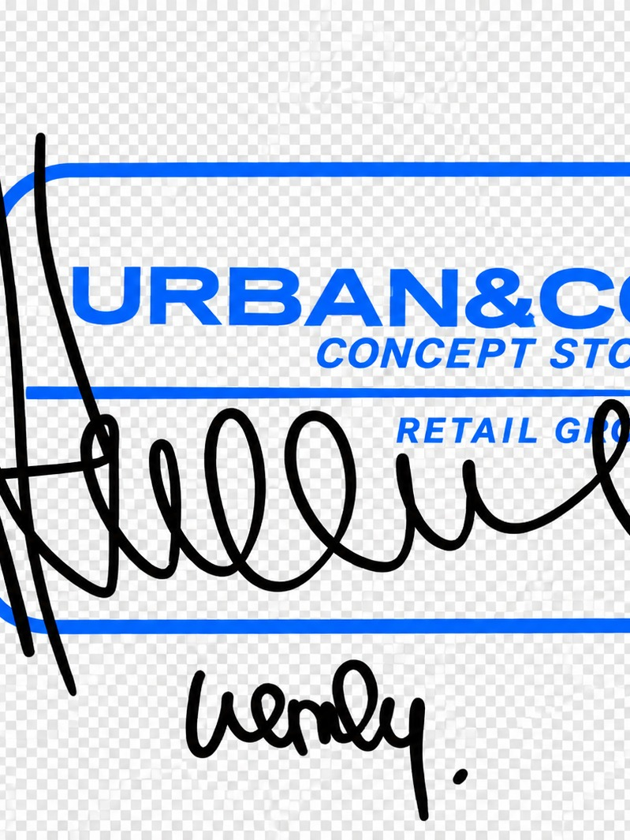
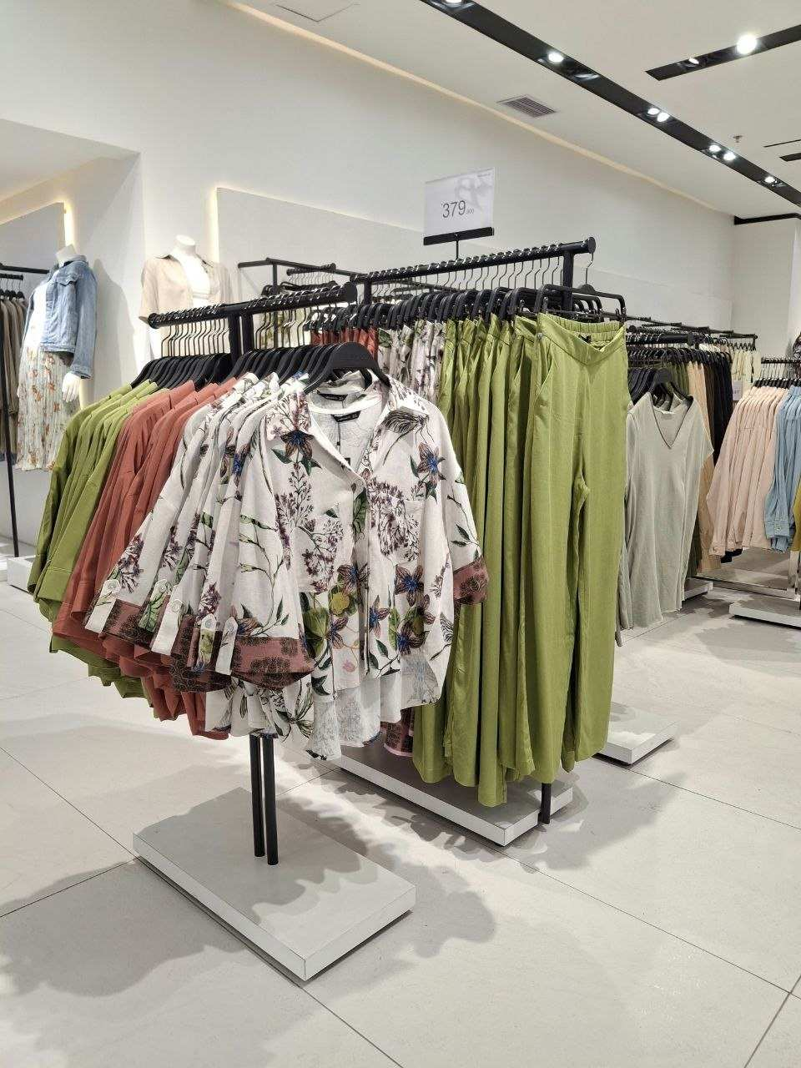
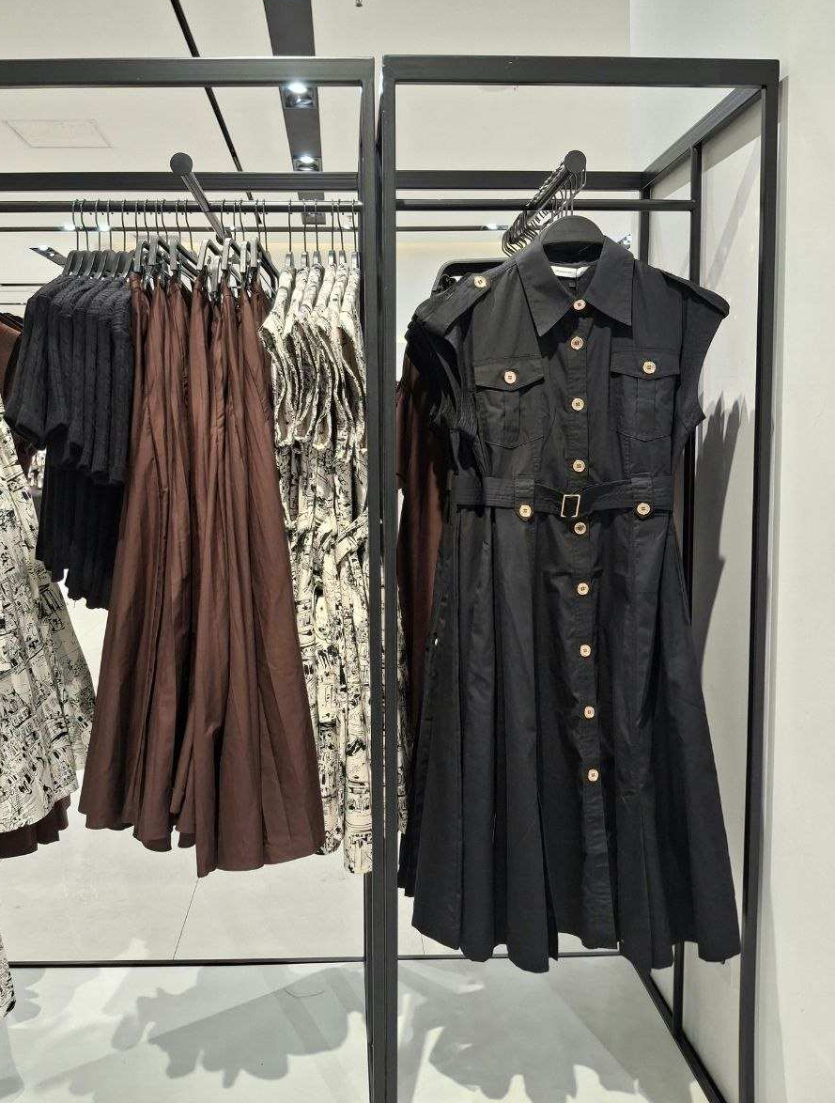
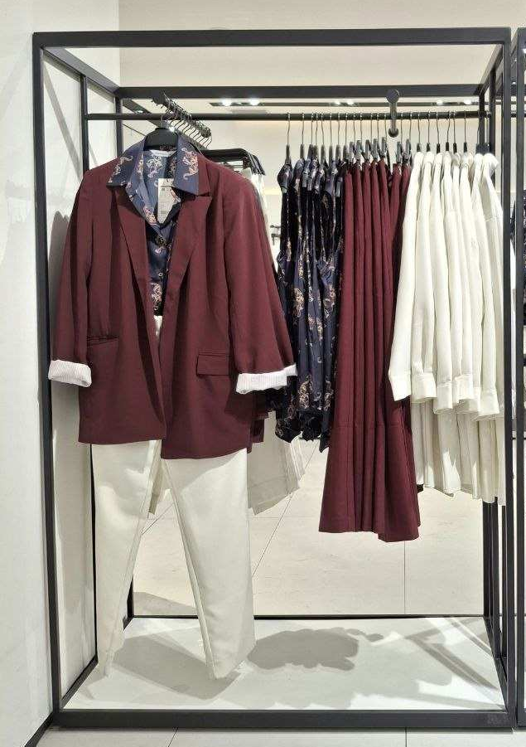

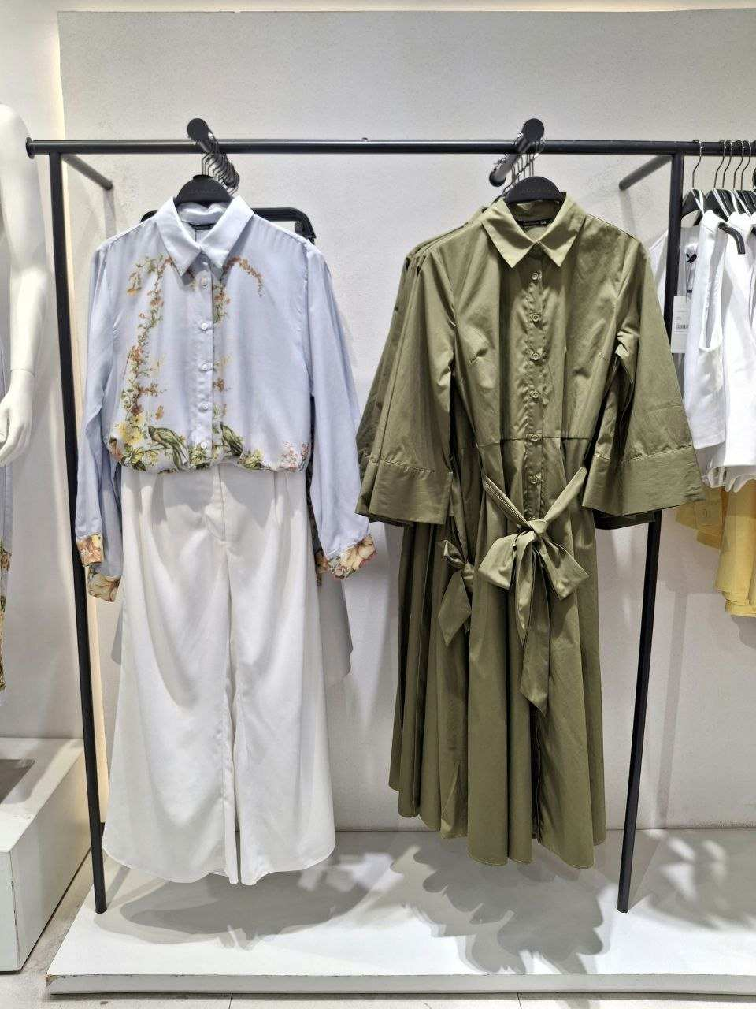
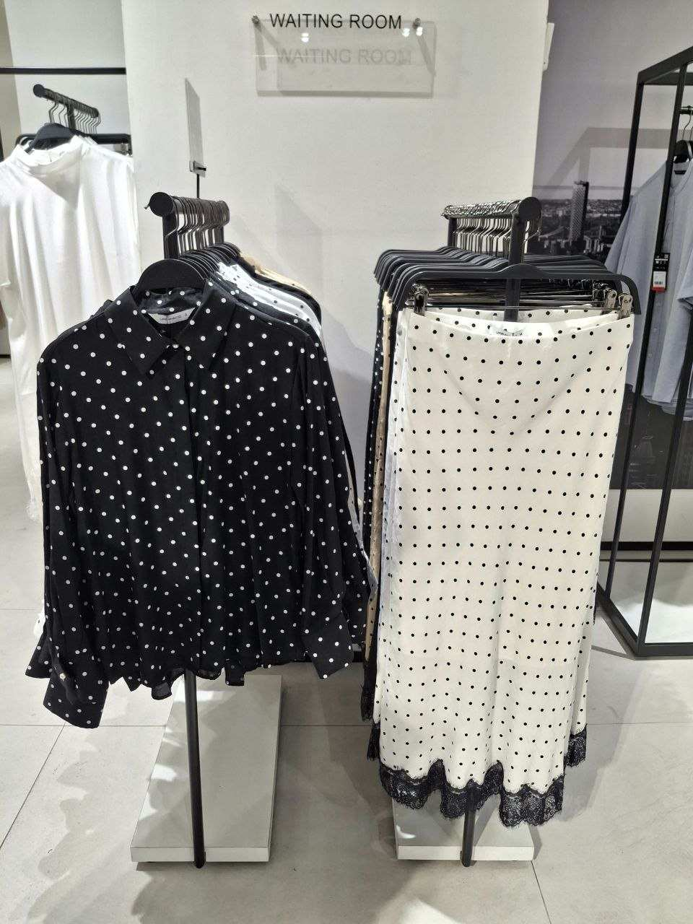
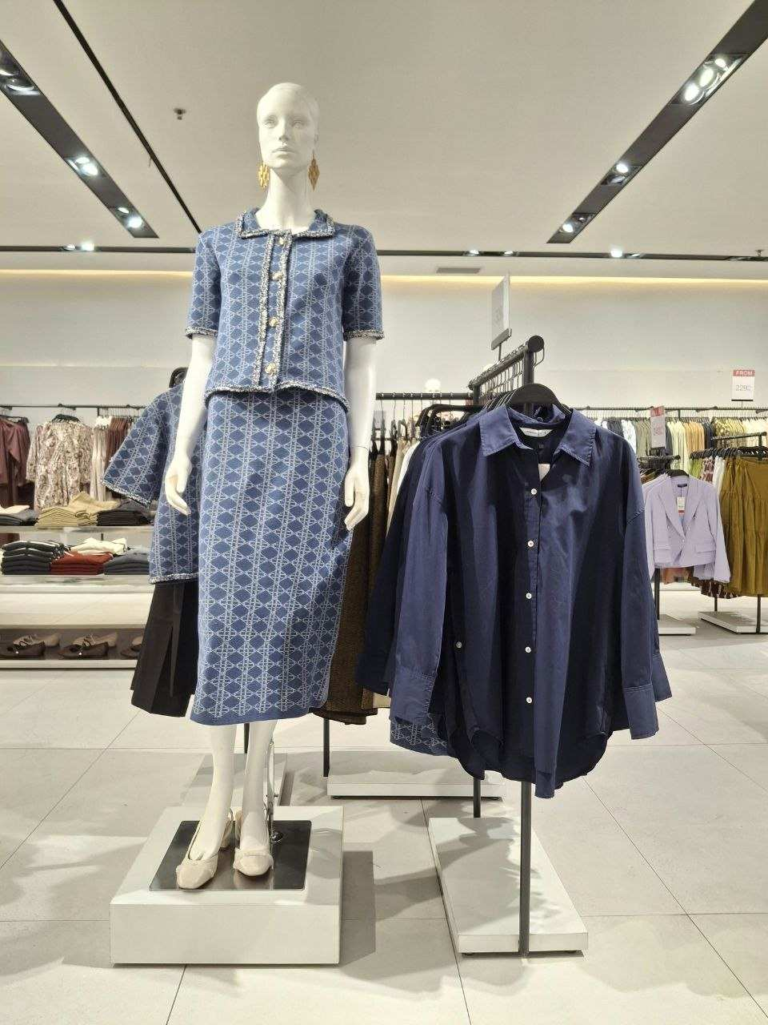
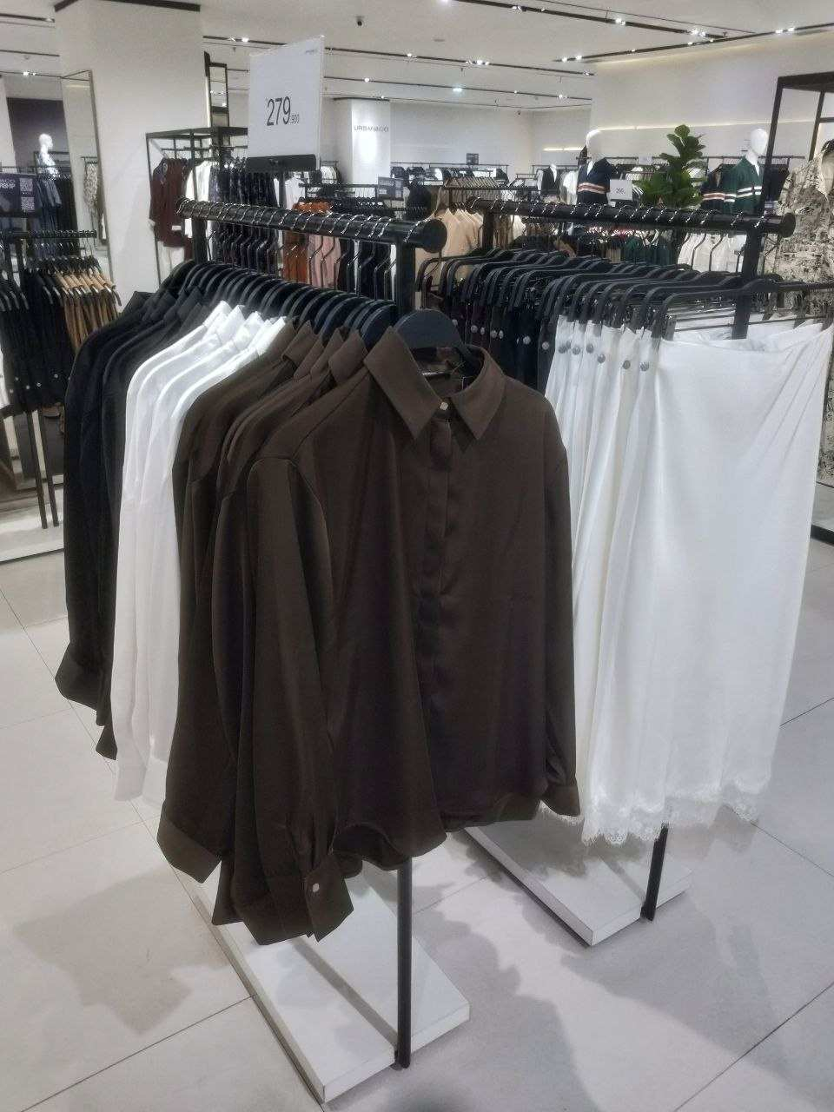
FESTIVAL CITYLINK
POSITION RANKING
19 – 25 OCT 2026
GLOBAL
NO STOCK
RANK 1
RANK 2
RANK 3
RANK 4
RANK 5
LAST PIECES
NO STOCK
RANK 6
RANK 7
RANK 8
RANK 9
RANK 10

Slide 4
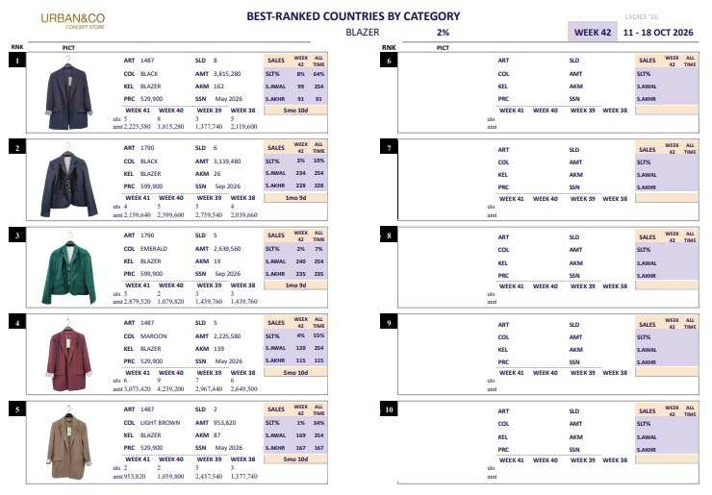
FESTIVAL CITYLINK
POSITION RANKING
19 – 25 OCT 2026

Slide 5
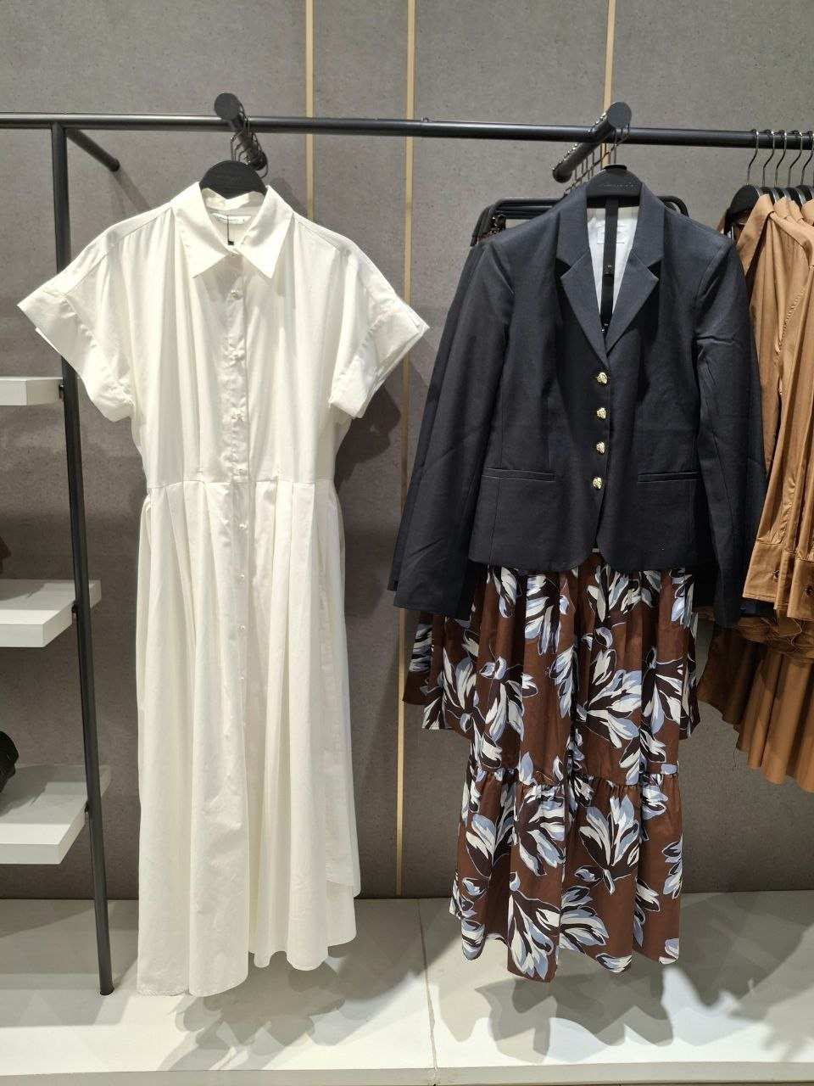
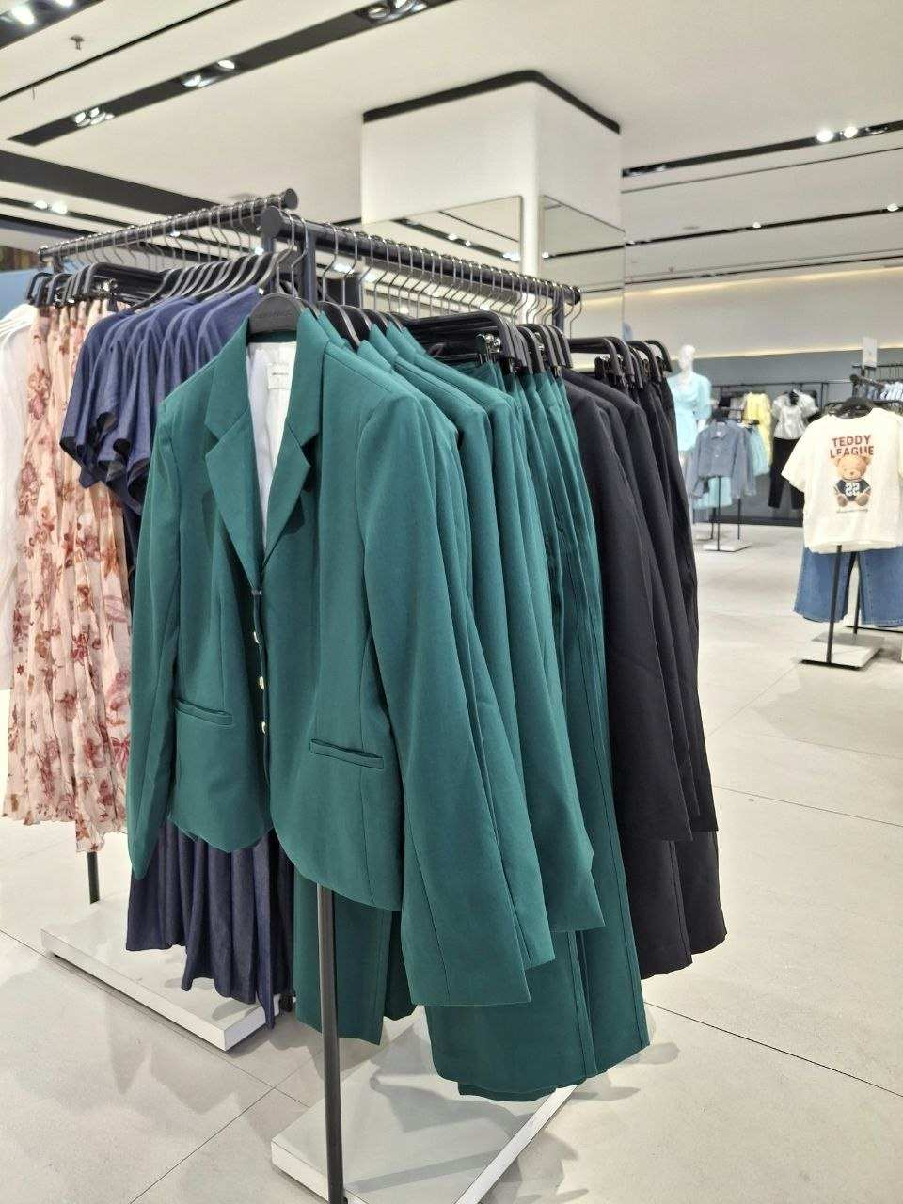
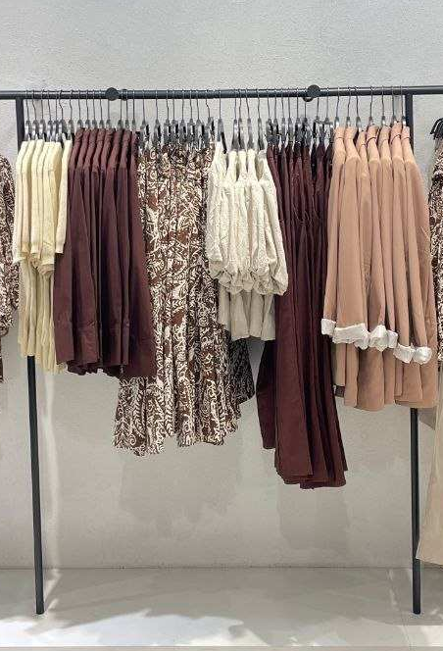
FESTIVAL CITYLINK
POSITION RANKING
19 – 25 OCT 2026
BLAZER
LAST PIECES
RANK 1
RANK 2
RANK 3
RANK 4
RANK 5
RANK 6
RANK 7
RANK 8
RANK 9
RANK 10

Slide 6
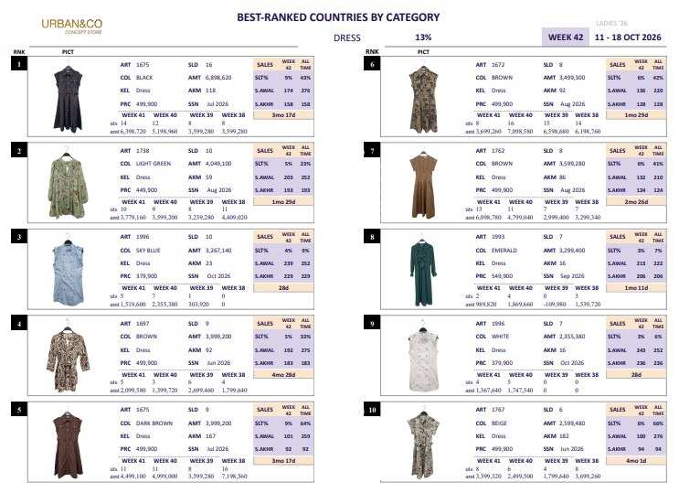
FESTIVAL CITYLINK
POSITION RANKING
19 – 25 OCT 2026

Slide 7
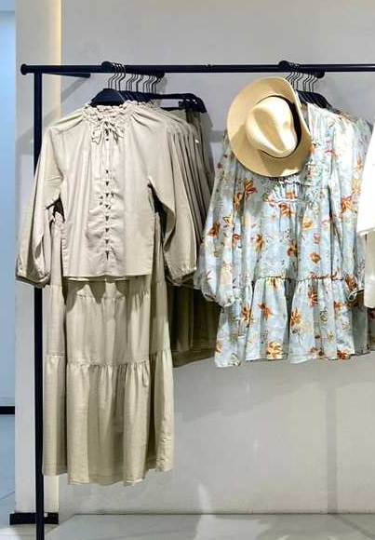
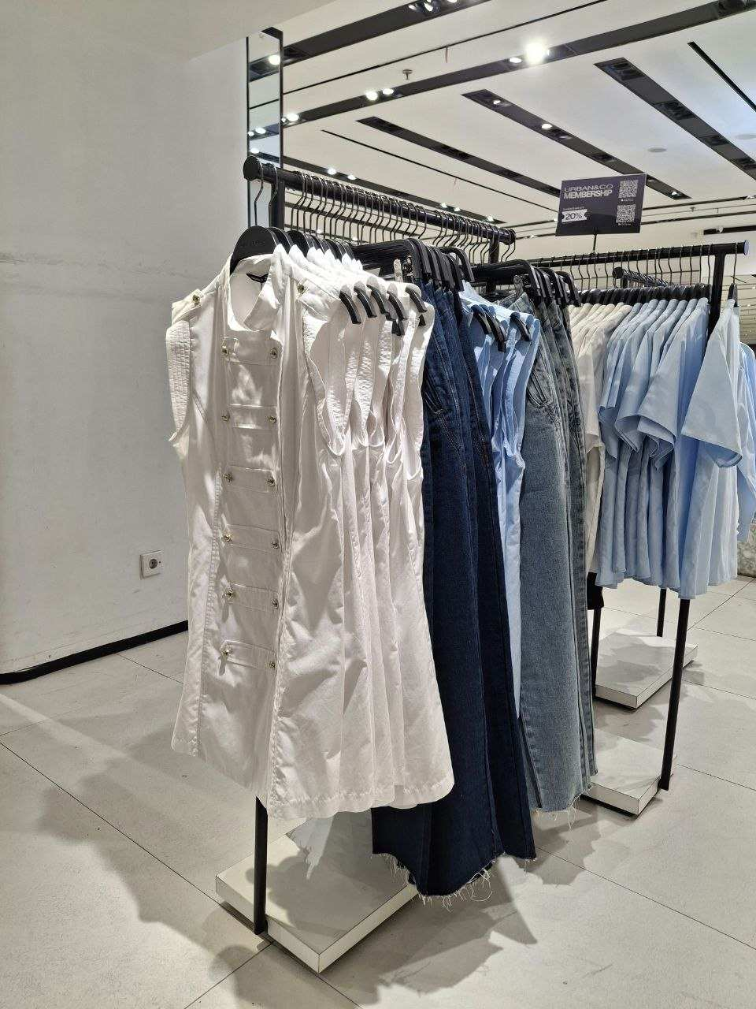
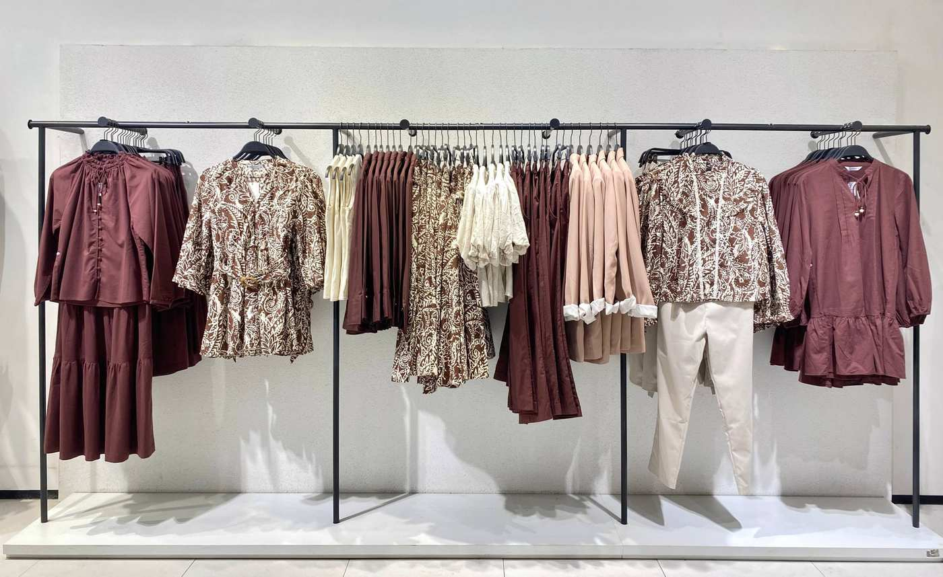
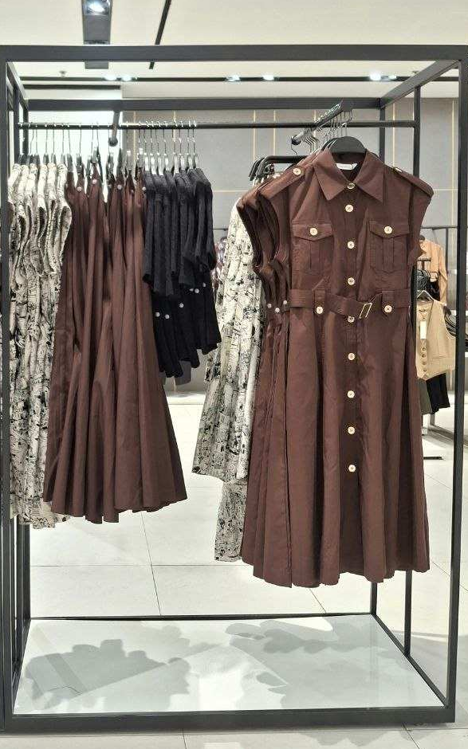
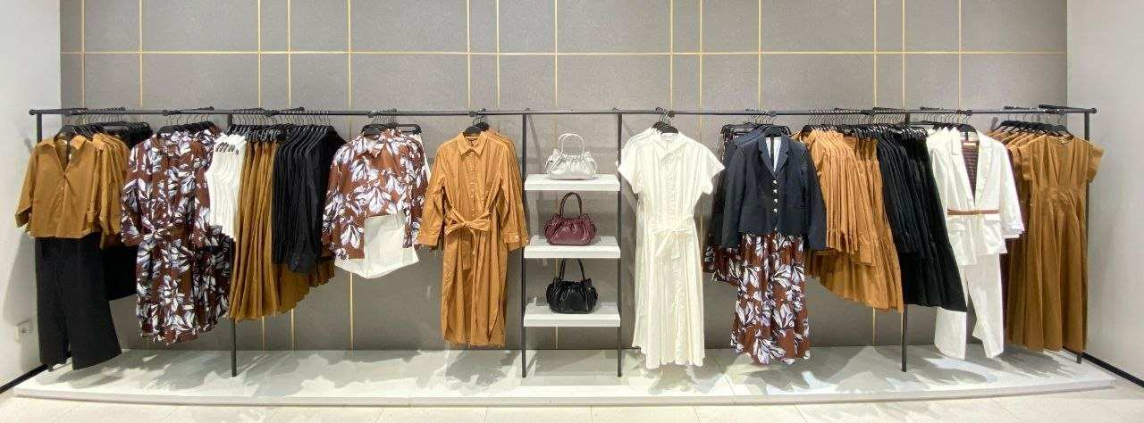
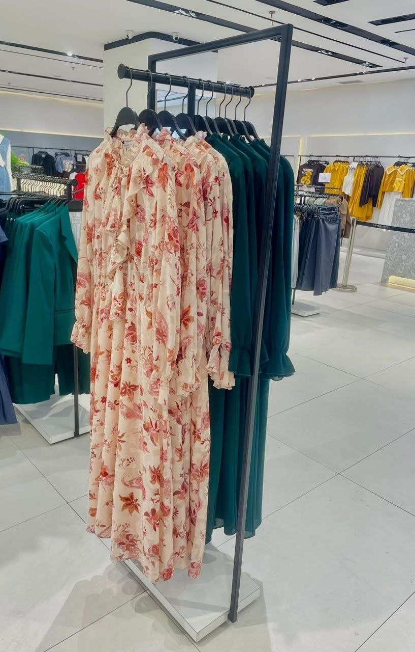
FESTIVAL CITYLINK
POSITION RANKING
19 – 25 OCT 2026
DRESS
RANK 1
RANK 2
RANK 3
RANK 4
RANK 5
LAST PIECES
RANK 6
RANK 7
RANK 8
RANK 9
RANK 10

Slide 8
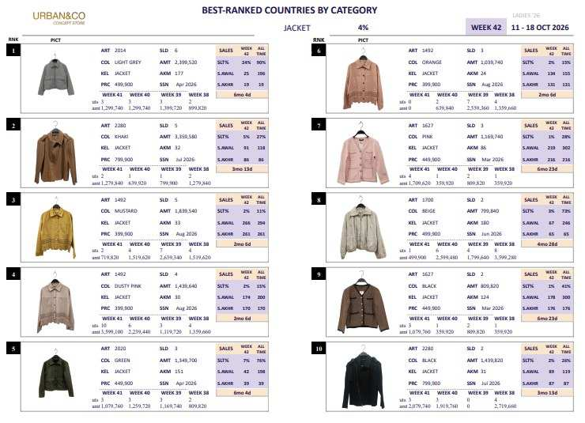
FESTIVAL CITYLINK
POSITION RANKING
19 – 25 OCT 2026

Slide 9
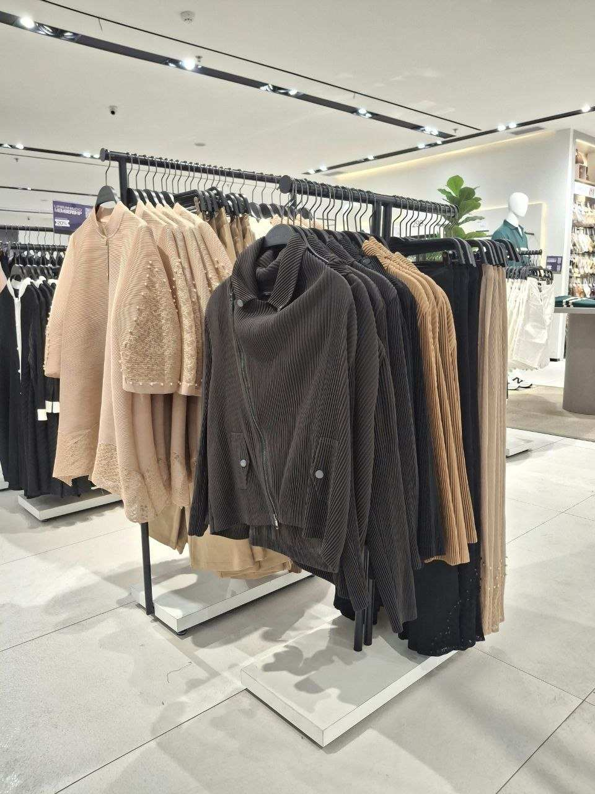
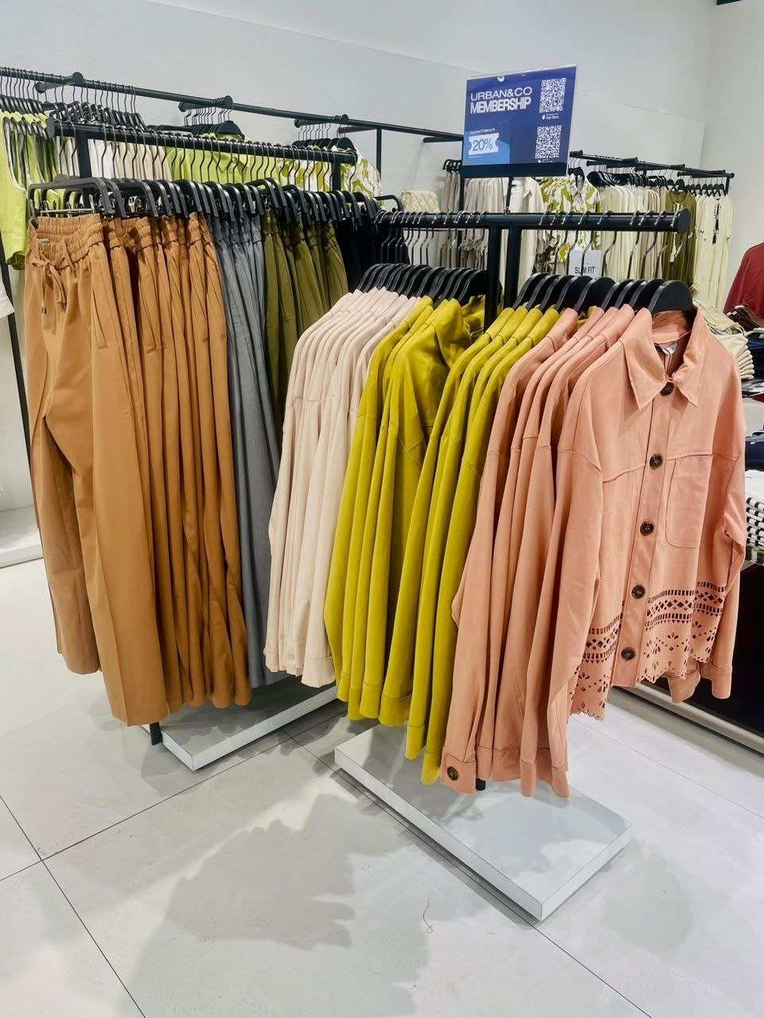
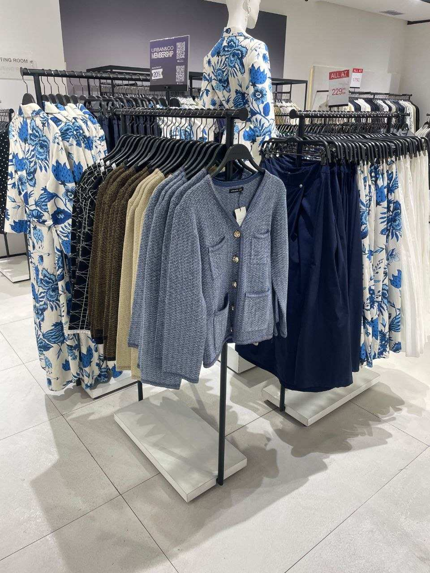
FESTIVAL CITYLINK
POSITION RANKING
19 – 25 OCT 2026
JACKET
LAST PIECES
LAST PIECES
RANK 1
RANK 2
RANK 3
RANK 4
RANK 5
LAST PIECES
RANK 6
RANK 7
RANK 8
RANK 9
RANK 10

Slide 10
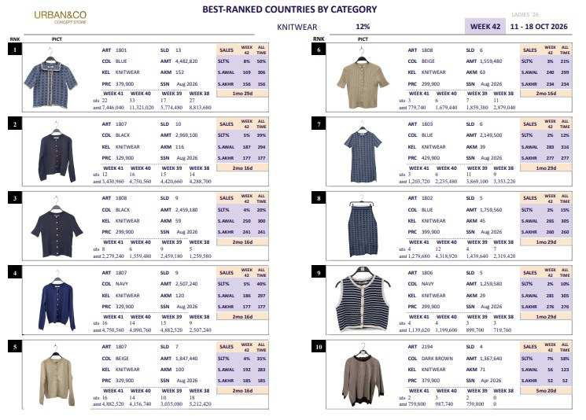
FESTIVAL CITYLINK
POSITION RANKING
19 – 25 OCT 2026

Slide 11
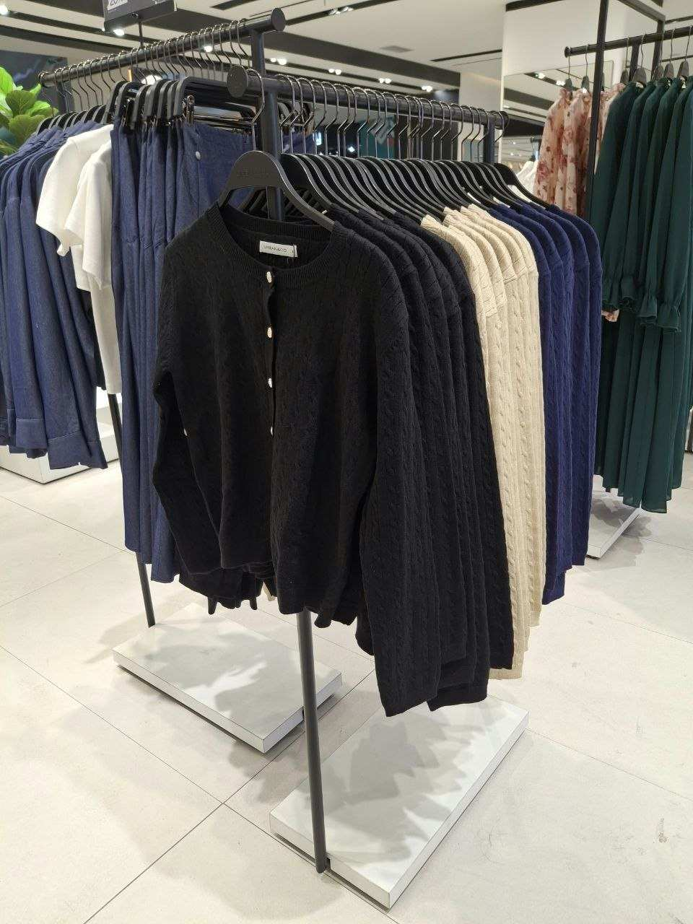
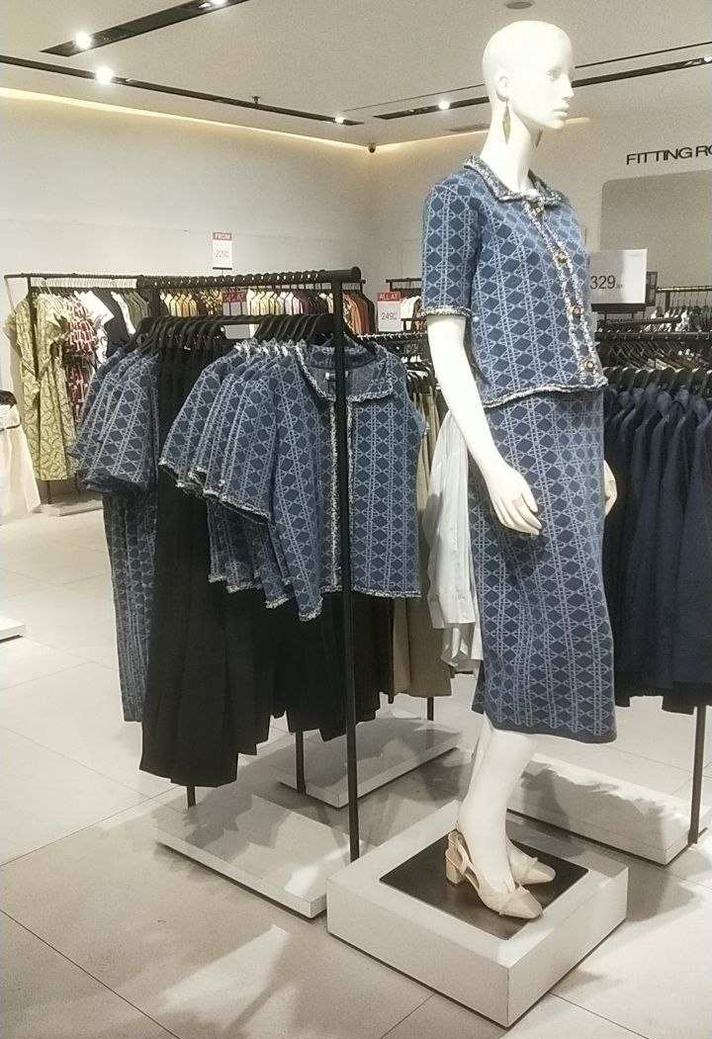
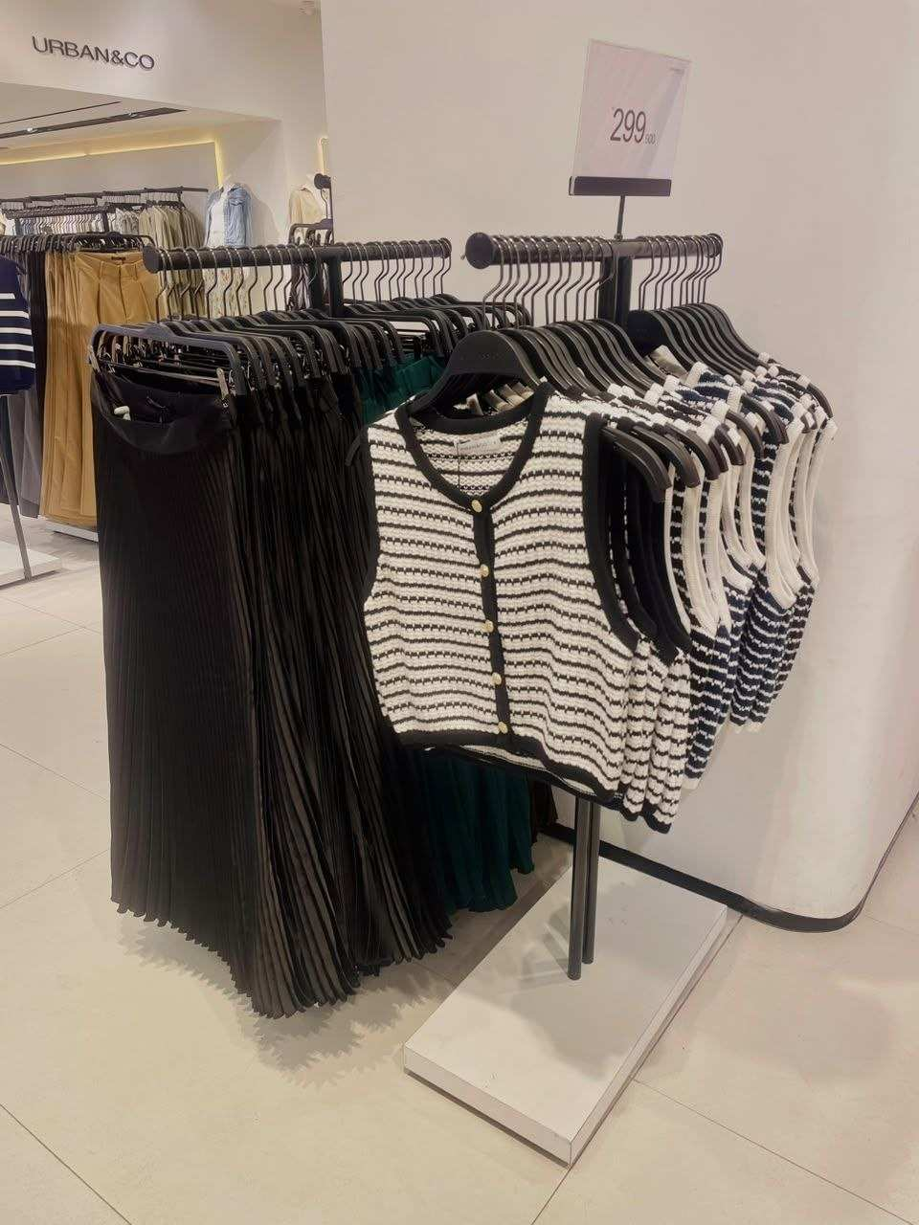
FESTIVAL CITYLINK
POSITION RANKING
19 – 25 OCT 2026
KNITWEAR
RANK 1
RANK 2
RANK 3
RANK 4
RANK 5
LAST PIECES
NO STOCK
RANK 6
RANK 7
RANK 8
RANK 9
RANK 10

Slide 12
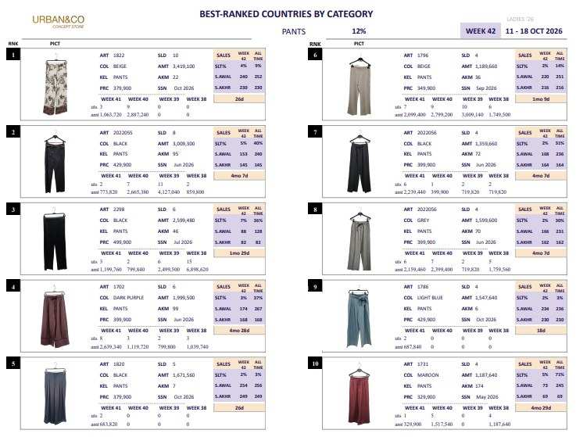
FESTIVAL CITYLINK
POSITION RANKING
19 – 25 OCT 2026

Slide 13
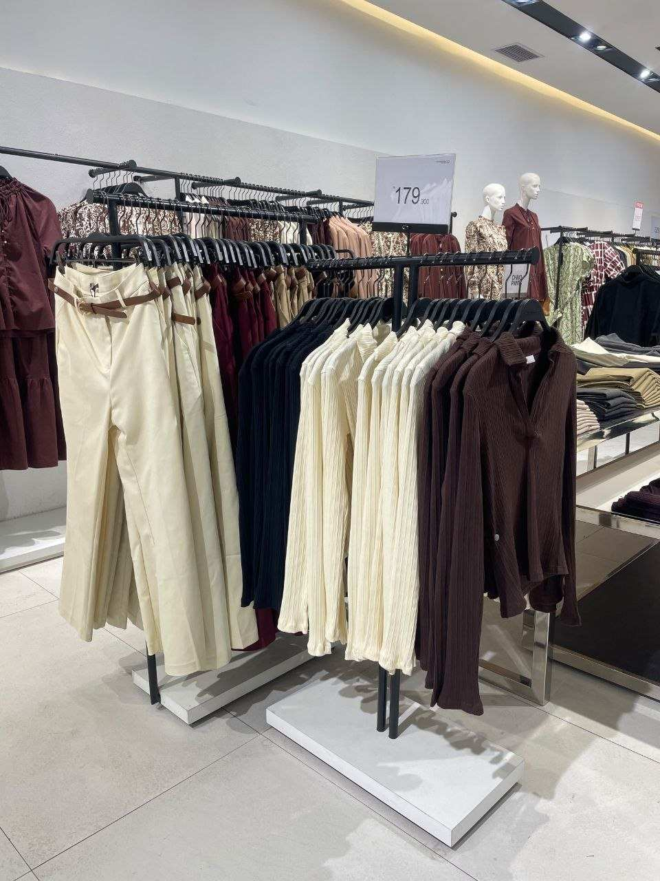
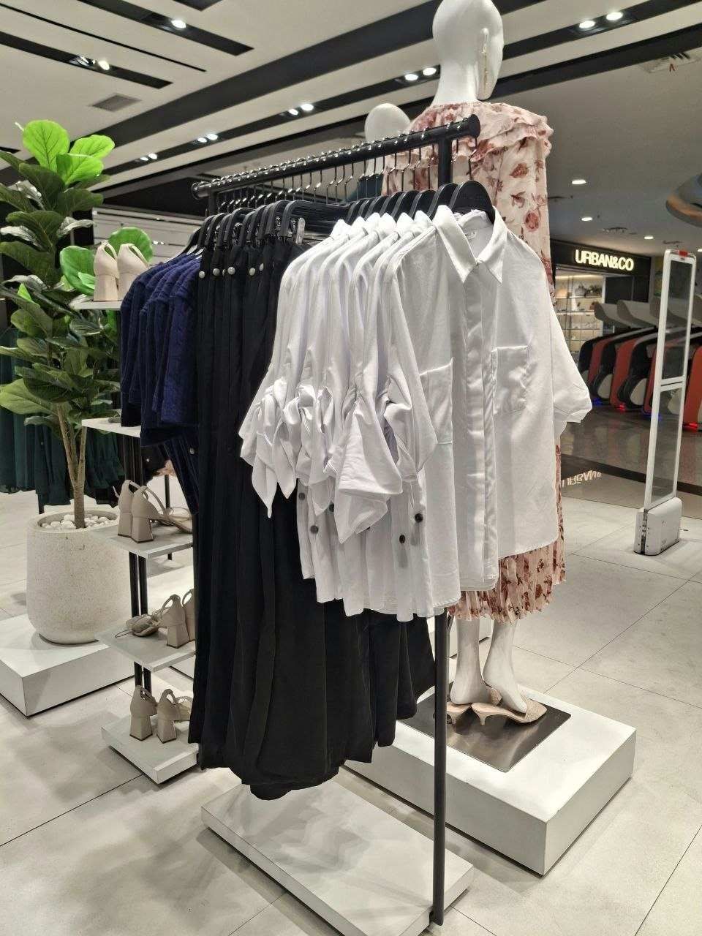
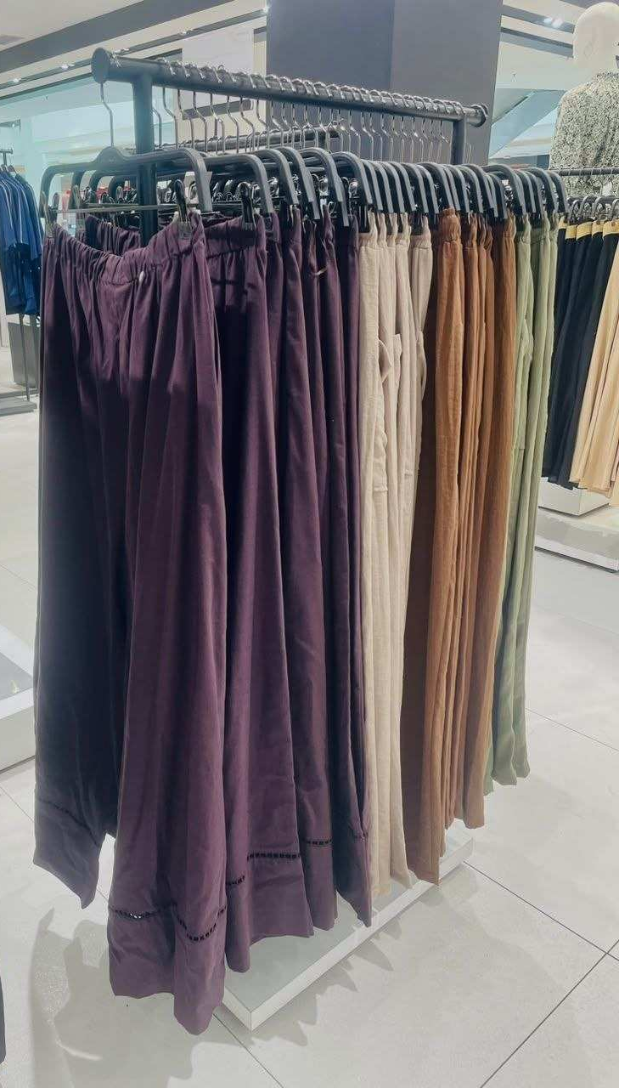


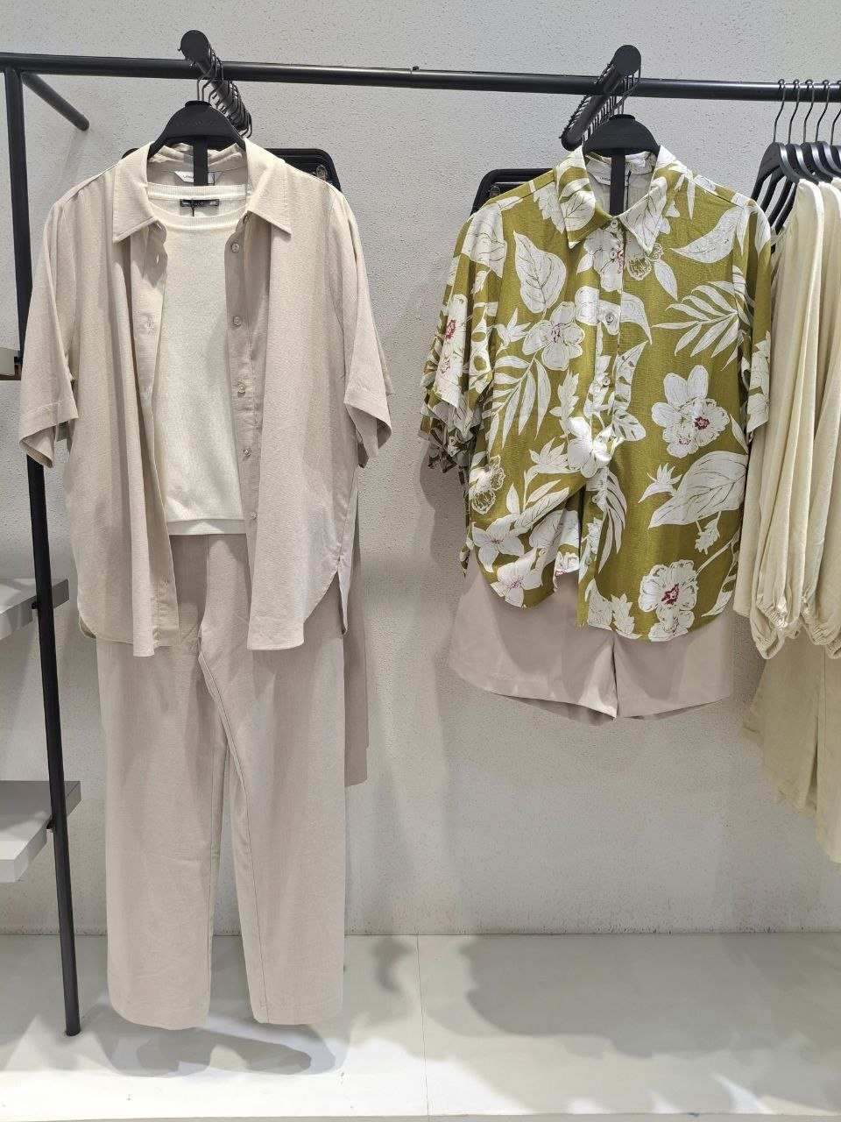
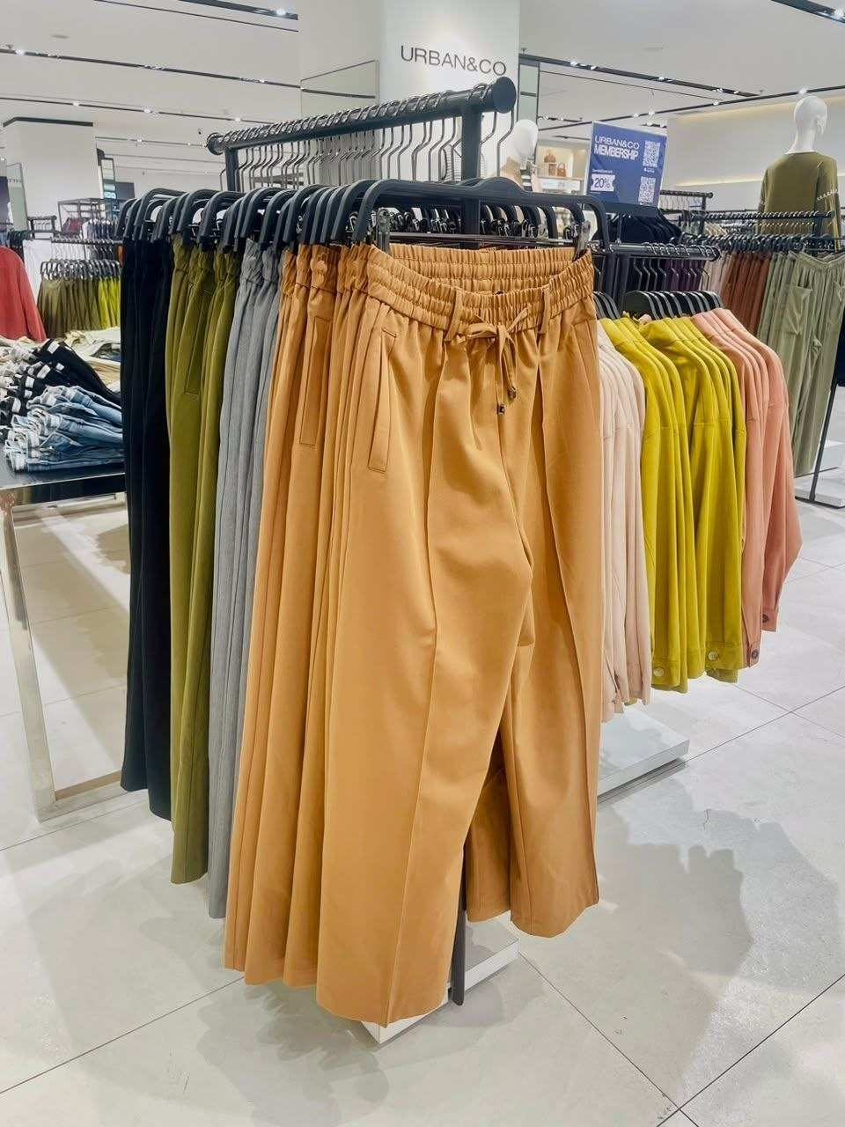
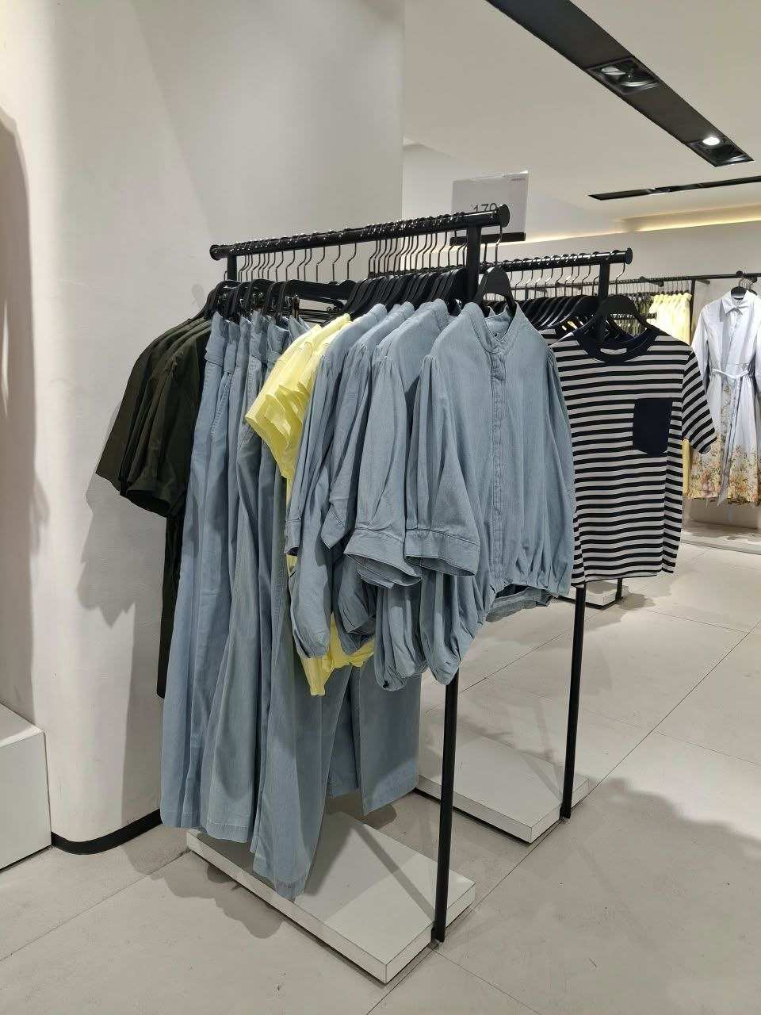
FESTIVAL CITYLINK
POSITION RANKING
19 – 25 OCT 2026
PANTS
RANK 1
RANK 2
RANK 3
RANK 4
RANK 5
LAST PIECES
RANK 6
RANK 7
RANK 8
RANK 9
RANK 10

Slide 14
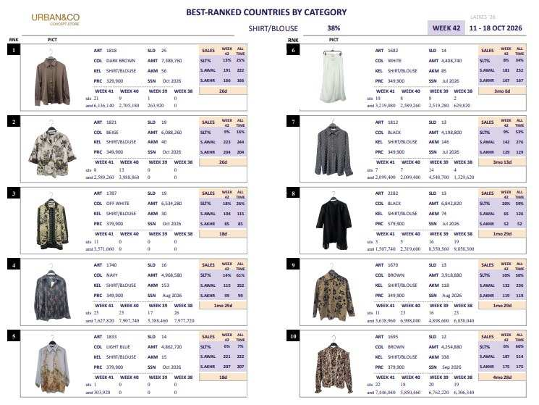
FESTIVAL CITYLINK
POSITION RANKING
19 – 25 OCT 2026

Slide 15
FESTIVAL CITYLINK
POSITION RANKING
19 – 25 OCT 2026
SHIRT
NO STOCK
RANK 1
RANK 2
RANK 3
RANK 4
RANK 5
LAST PIECES
LAST PIECES
LAST PIECES
RANK 6
RANK 7
RANK 8
RANK 9
RANK 10

Slide 16
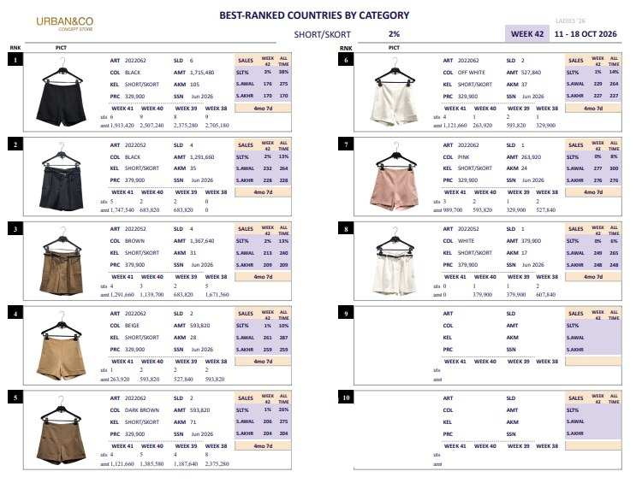
FESTIVAL CITYLINK
POSITION RANKING
19 – 25 OCT 2026

Slide 17
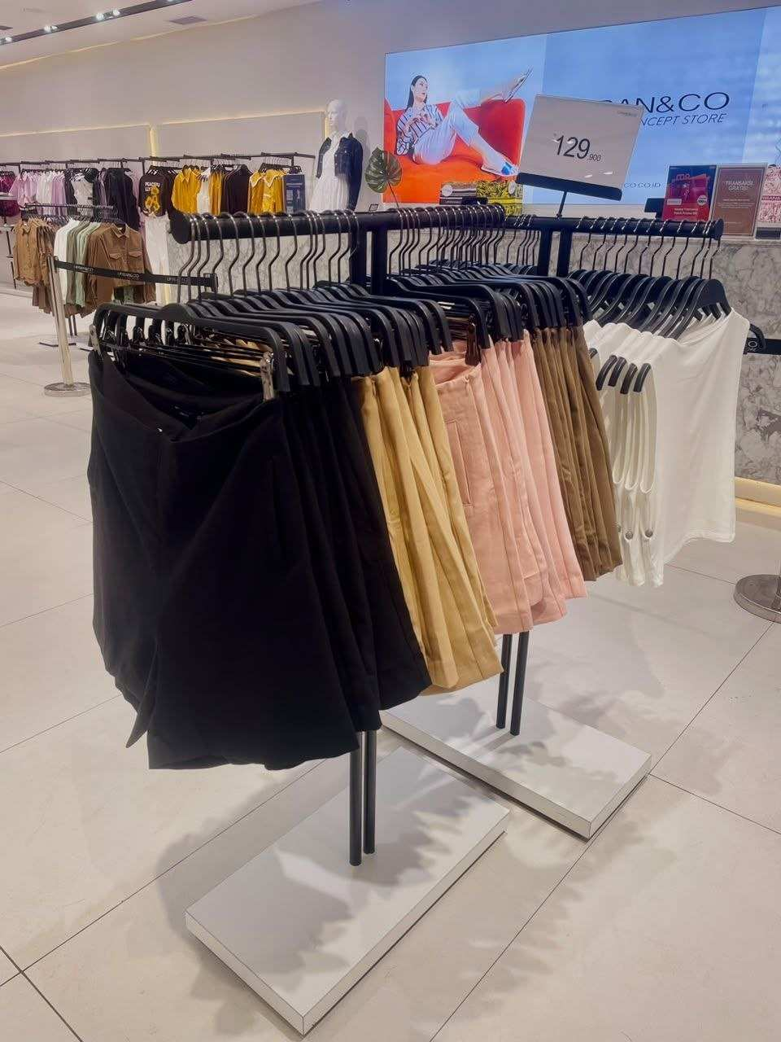
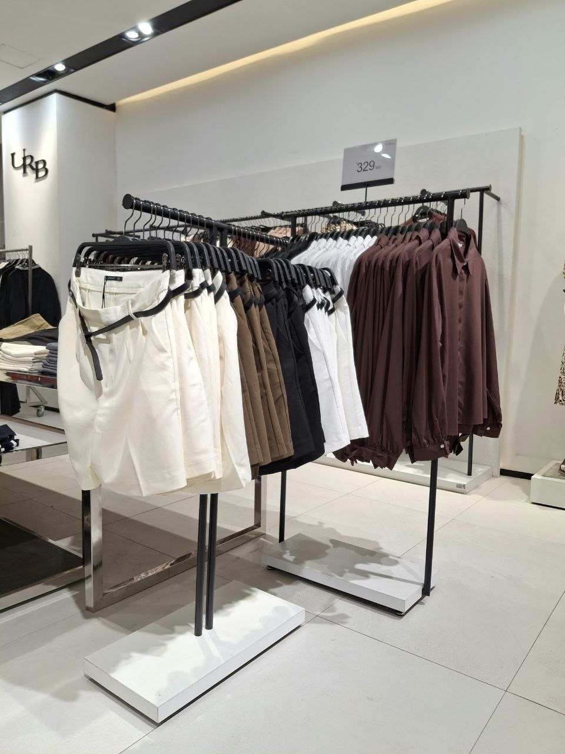

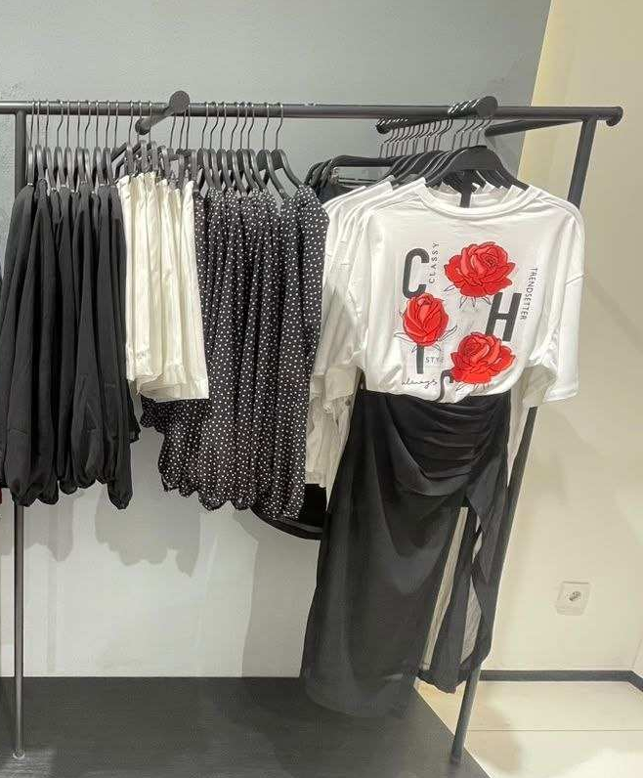
FESTIVAL CITYLINK
POSITION RANKING
19 – 25 OCT 2026
SHORT
RANK 1
RANK 2
RANK 3
RANK 4
RANK 5
RANK 6
RANK 7
RANK 8
RANK 9
RANK 10

Slide 18
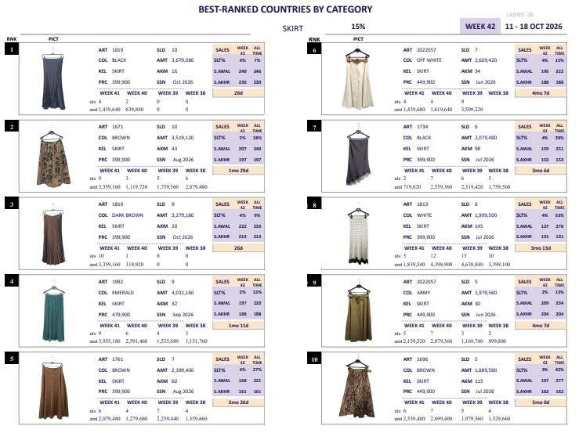
FESTIVAL CITYLINK
POSITION RANKING
19 – 25 OCT 2026

Slide 19
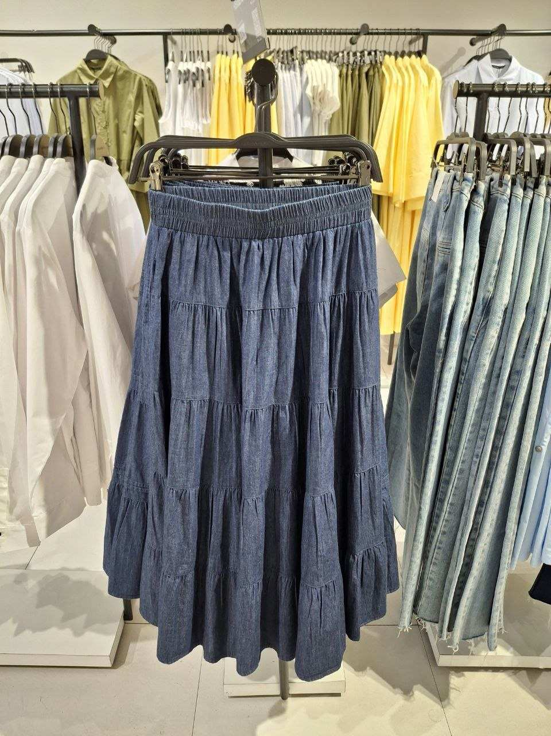
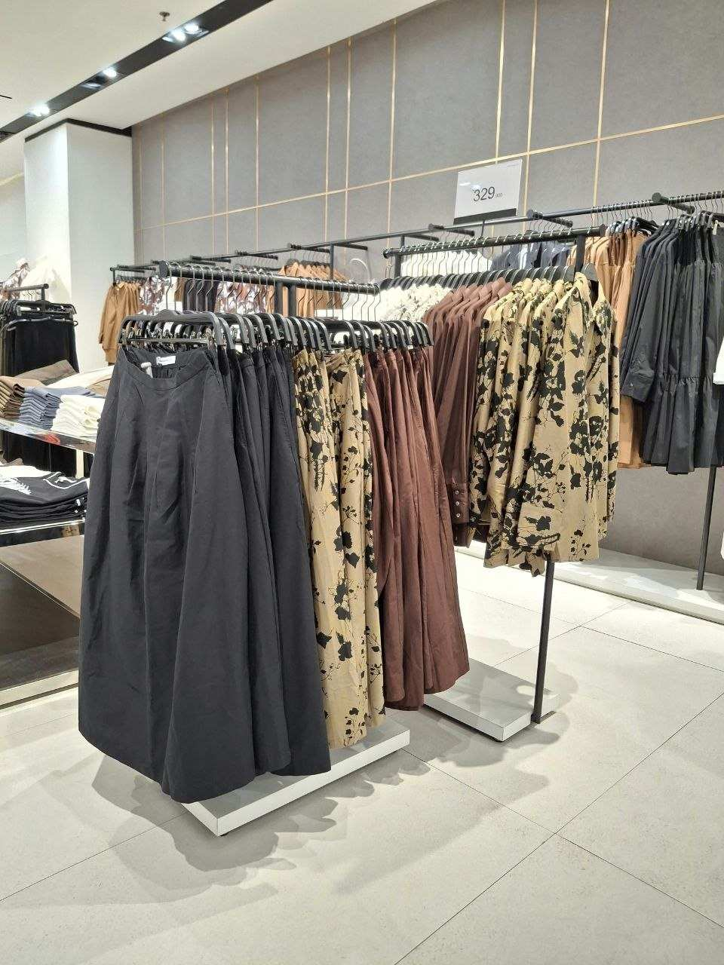
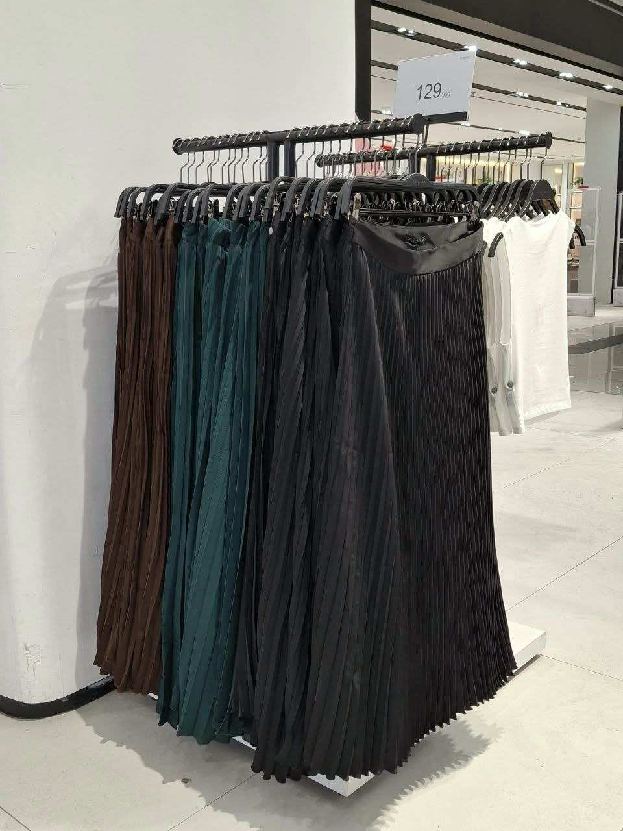
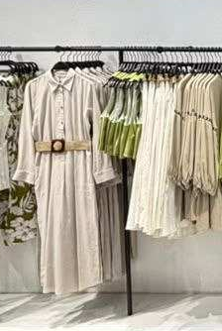
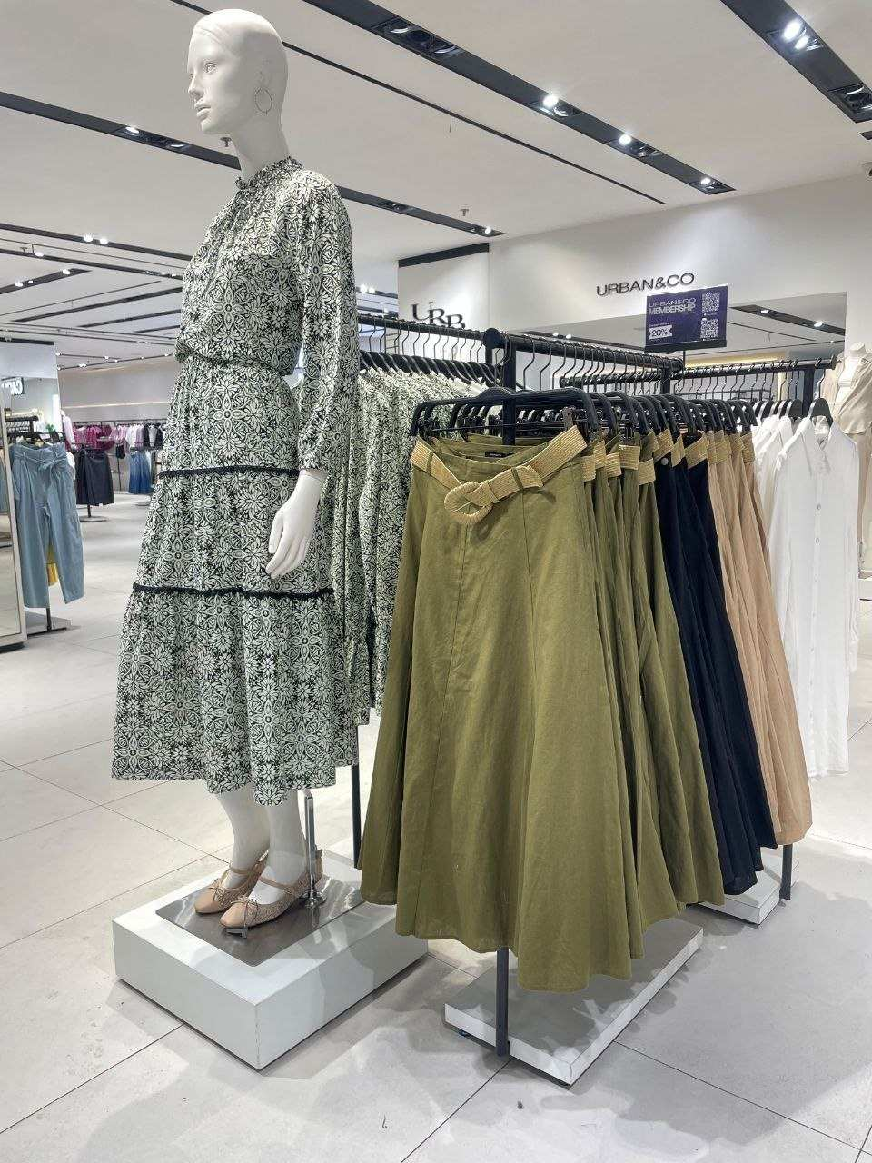
FESTIVAL CITYLINK
POSITION RANKING
19 – 25 OCT 2026
SKIRT
RANK 1
RANK 2
RANK 3
RANK 4
RANK 5
LAST PIECES
RANK 6
RANK 7
RANK 8
RANK 9
RANK 10

Slide 20
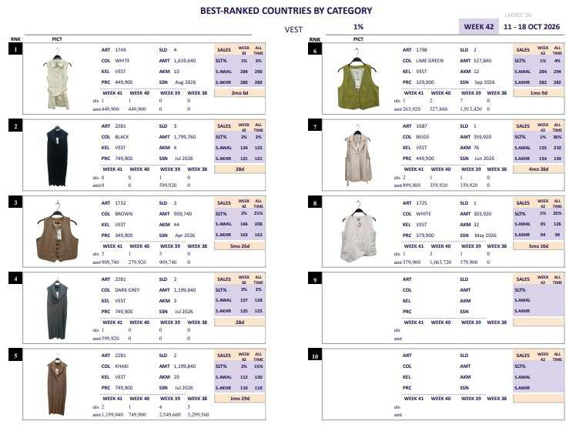
FESTIVAL CITYLINK
POSITION RANKING
19 – 25 OCT 2026

Slide 21
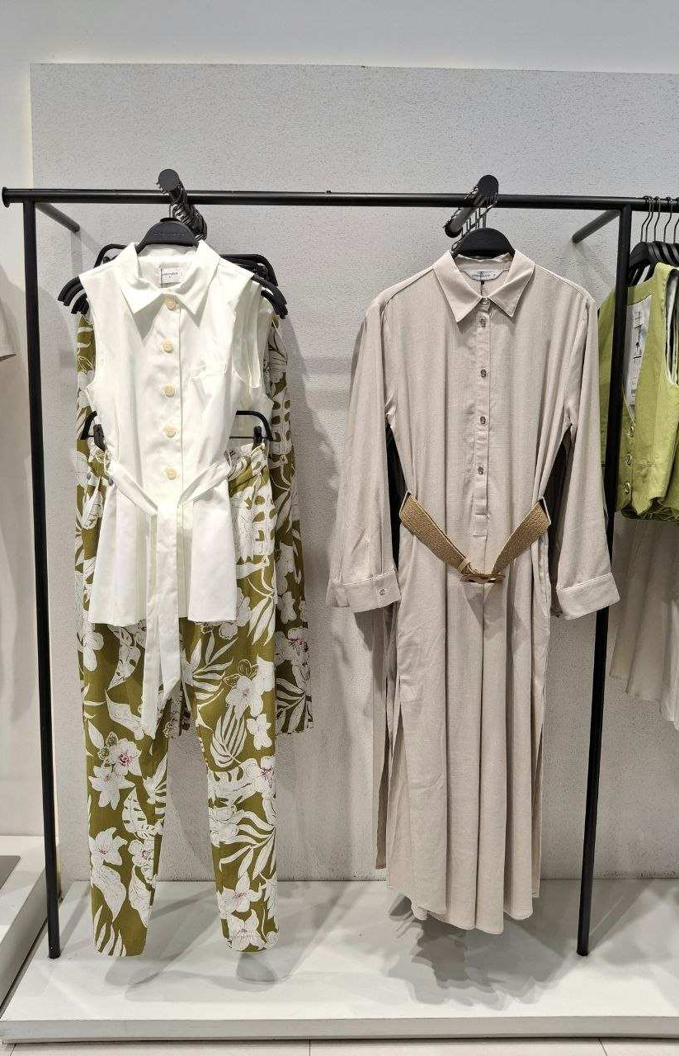
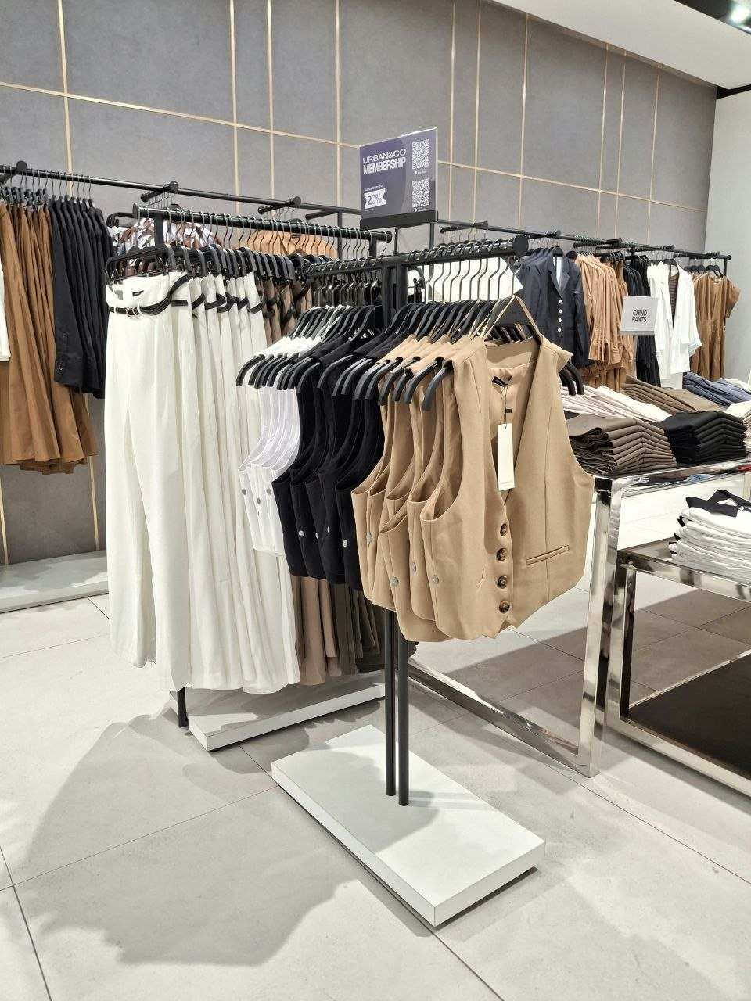



FESTIVAL CITYLINK
POSITION RANKING
19 – 25 OCT 2026
VEST
NO STOCK
NO STOCK
RANK 1
RANK 2
RANK 3
RANK 4
RANK 5
RANK 6
RANK 7
RANK 8
RANK 9
RANK 10

Slide 22


FESTIVAL CITYLINK
POSITION RANKING
19 – 25 OCT 2026

Slide 23

FESTIVAL CITYLINK
POSITION RANKING
19 – 25 OCT 2026
DENIM PANTS
LAST PIECES
LAST PIECES
RANK 1
RANK 2
RANK 3
RANK 4
RANK 5
RANK 6
RANK 7
RANK 8
RANK 9
RANK 10

Slide 24

FESTIVAL CITYLINK
POSITION RANKING
19 – 25 OCT 2026

Slide 25

FESTIVAL CITYLINK
POSITION RANKING
19 – 25 OCT 2026
SKIRT
LAST PIECES
LAST PIECES
RANK 1
RANK 2
RANK 3
RANK 4
RANK 5
RANK 6
RANK 7
RANK 8
RANK 9
RANK 10

Slide 26



